Slide 1
Simulation and Modeling
CSE4131_CSE4132

Slide 2
Tests For Random Numbers
The desired properties of Random Numbers:
Uniformity & Independence
To ensure … desired properties… number of tests can be performed

Slide 3
Tests For Random Numbers
Five types of tests:
Frequency test
Runs Test
Autocorrelation test
Gap test
Poker test
Uniformity test
Independence test

Slide 4
Frequency Test
Used to test uniformity
Uses:
Kolmogorov-Smirnov test or
Chi-square test
We will study from N.Deo’s Book

Slide 5
Frequency Test
There should be no favored number.
That is, no number should occur more frequently than what is expected from chance variation.
For example,
If we have 5000 3-digit numbers (000-999)
We should expect-
000-099 → 500 numbers
100-199 → 500 numbers
200-299 → 500 numbers
… … …
900-999 → 500 numbers

Slide 6
Frequency Test
We do not expect … exact 500 … in each of the 10 ranges
In fact, if we found… we should suspect nonrandomness.
… deviation from 500 should not be too much
Suspect → nonuniformity
How much deviation should be accepted?
500±x ; x = ?
Chi-square test

Slide 7
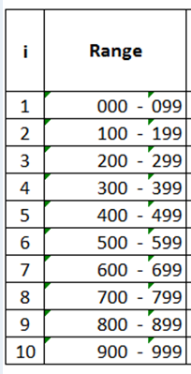
Chi-square test(2015)
Steps
Dividing the observed data into k non overlapping classes.
Observed data → generated random number
K ≥ 3 (must be)
If we have 5000 3-digit numbers (000-999) → 10 non overlapping classes:

Slide 8
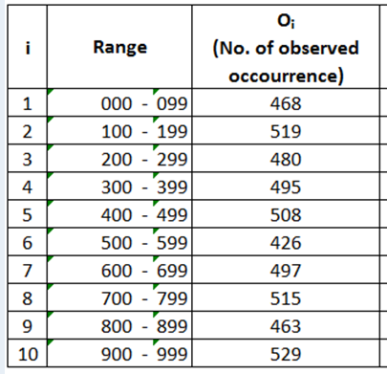
Chi-square test
Then we count O_{i} the number of times observed data fall into each class i
For i=1,2,….k

Slide 9
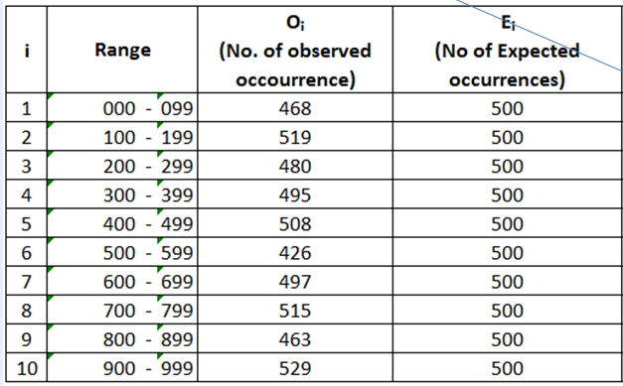
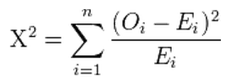
Chi-square test
We determine the expected number occurrences E_{i} in each class i
Then we calculate chi-square value:

Slide 10
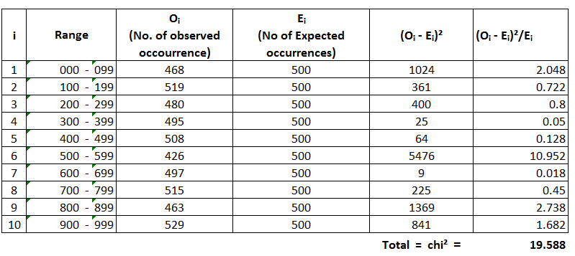
Example
(468-500)^2=(-32)^2=1024
1024/500= 2.048

Slide 11
Chi-square test
The question now arises:
how large or small a computed value of chi-square can we accept.
New term:
chi-square table…. Predefined
New Parameter:
degree of freedom
Defined by: v=k-1 , k → no of sets into which data is divided
In our example k=10, that is v=10-1=9

Slide 12
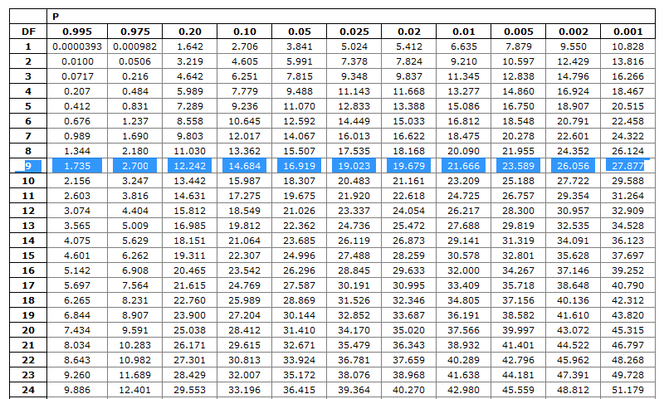
Chi-square table

Slide 13
Chi-square table
99.5% probability chi² will exceeding → 1.735
97.5% probability chi² will exceeding → 2.700
0.5% probability chi² will exceeding → 23.589
Thus the probability of the chi² statistic (for v=9) falling below 1.73 and
above 23.6 is only 1%
That is 990 out of 1000 sequences from a perfectly uniform random number
generator would have given:
1.73 ≤ chi² ≤ 23.6

Slide 14
Tests For Random Numbers
Five types of tests:
Frequency test
Runs Test
Autocorrelation test
Gap test
Poker test
Uniformity test
Just Discussed
Independence test

Slide 15
Runs Test
Usually 3 types of tests…
Runs up and down
Runs above and below the mean.
Runs test: length of runs.

